Slide 1


Slide 2
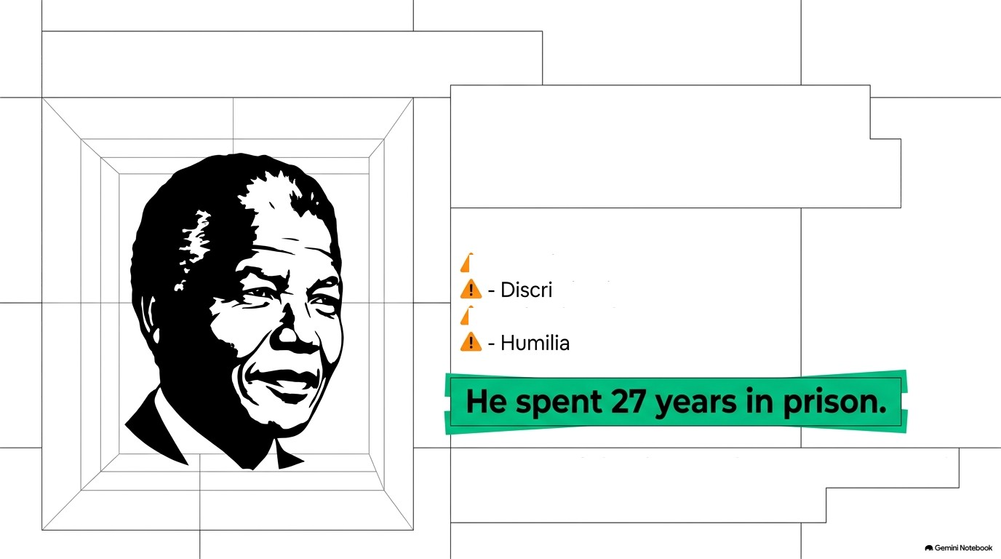
The Ideal of Freedom
Nelson Mandela
In his aUtObiography, Mandela described life under the Apartheid regime in South Africa.
Apartheid involved:
i‹ - Racial segregation
mination
› - Police brutality
tion and hardships
He realised that his{reedom was connected
with the{reedom o(his people.
savvy.maam

Slide 3
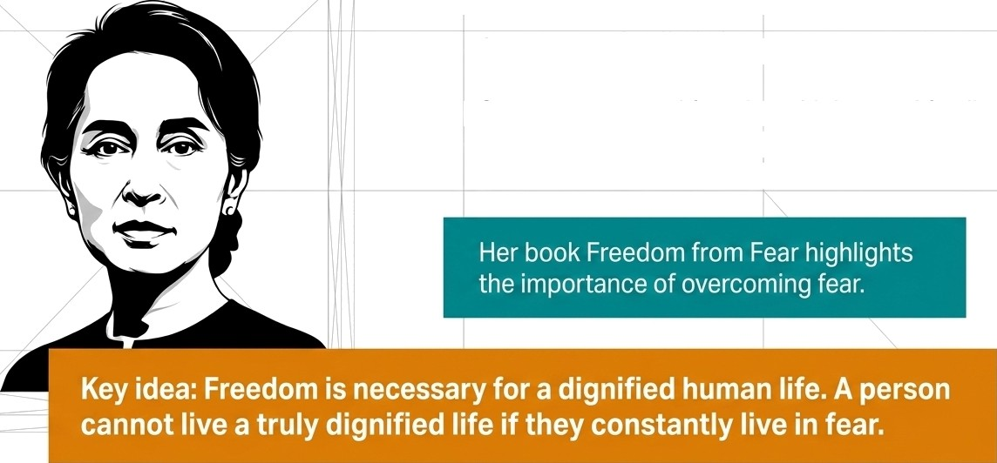
The Ideal of Freedom
Aung San Suu Kyi
She spent many years under house arrest in
Myanmar.
She was separated from her children and family.
Her idea of freedom was closely connected with
the freedom of her people.
savvy.maam

Slide 4
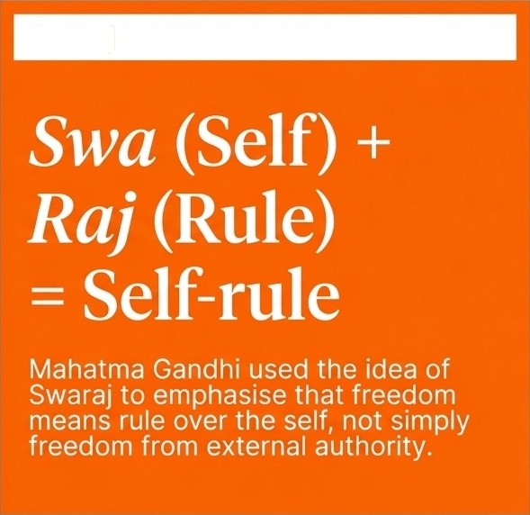




What is Freedom?
Freedom means the absence of unjustified constraints on an individual.
It means a person should:
Swaraj
Make independent decisions
Express
themselves
Develop their potential
Live their life with dignity
e
Constraint Alert
Freedom Complete absence of restrictions. Some restrictions are justified and necessary for society.
Example: A society may restrict p1aying loud music late at night
savvy.maam

Slide 5




Sources of Constraints
Constraints can come from:
1. Government / Laws 2. Social Inequality
The state creaies laws that restrict certain actions.
Social and economic inequalities can restrict people's freedom. For example, poverty may prevent a person from getting proper education or choosing the work they want.
3. External Controls
Restriciions imposed by other people or institutions can limit individual freedom.
4. Domination
When some individuals or
groups have excessive power over others, it can lead to domination and restrict freedom.
savvy.maam

Slide 6
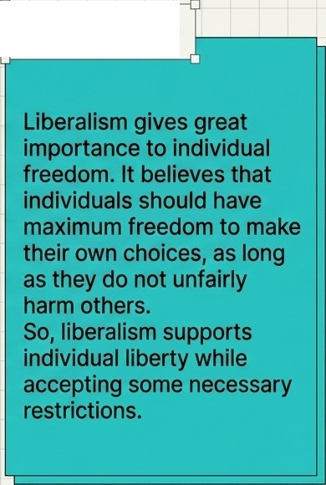
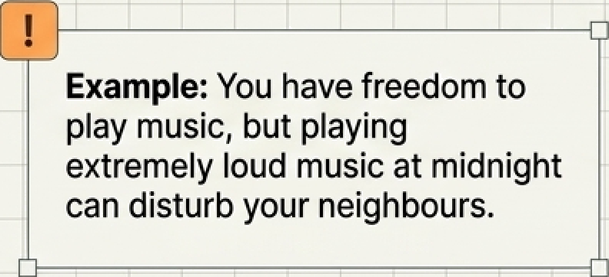
Why Do We Need Constraints?
Individual Freedom
vs Social Control
Society places certain restrictions on individuals to maintain:
t Liberalism
At first, freedom may seem to mean no restrictions. But complete absence of restrictions can create conflicts between individuals.
Why? Because one person's freedom can interfere with another person's freedom.
Peace
Order
Security
Freedom of others
Which restrictions are justified and which are not?
savvy.maam

Slide 7






Harm Principle J.S. Mill
J.S. Mill explained the relationship between individual freedom and social control. His central idea is the Harm Principle: An individual should be free to act as they wish, provided their actions do not cause harm to others.
Self-regarding actions
Mainly affect the individual themselves. Society should generally not interfere.
Example: If someone chooses a particular hairstyle + mainly self-regarding -+ NO Interference.
Two types of
actions
Other-regarding actions
Affect or harm other people. Society may legitimately place restrictions on them.
Example: If someone drives dangerously and puts other people's lives at risk -+ other-regarding e RESTRICTION Justified.
savvy.maam

Slide 8
Two Dimensions
of Freedom
Negative Liberty
Means freedom from external interference. The individual should have a private sphere where others, especially the state, should not interfere unnecessarily.
key idea:
- Freedom from interference.
Positive Liberty
Means having the conditions and opportunities necessary to develop yourself. It is not enough to simply remove restrictions; people should also have the ability to actually use their freedom.
Key idea:
-+ Freedom to develop and act.
Example: A child may be legally free to study, but without access to education, that freedom cannot be meaningfully exercised.
savvy.maam

Slide 9



Freedom of Expression
Mill
Mill strongly defended freedom of expression.
Why should people be free to express their opinions?
Our opinion may be wrong: Allowing
o different opinions helps us discover our
mistakes.
Even a wrong opinion can contain some
e truth: Discussion helps us understand the
truth more completely.
Truth becomes stronger through debate:
B If an opinion is never challenged, people may accept it mechanically without understanding why it is true.
Freedom of thought develops individuals:
B Open discussion encourages people to think, question and develop their reasoning.
savvy.maam

Slide 10
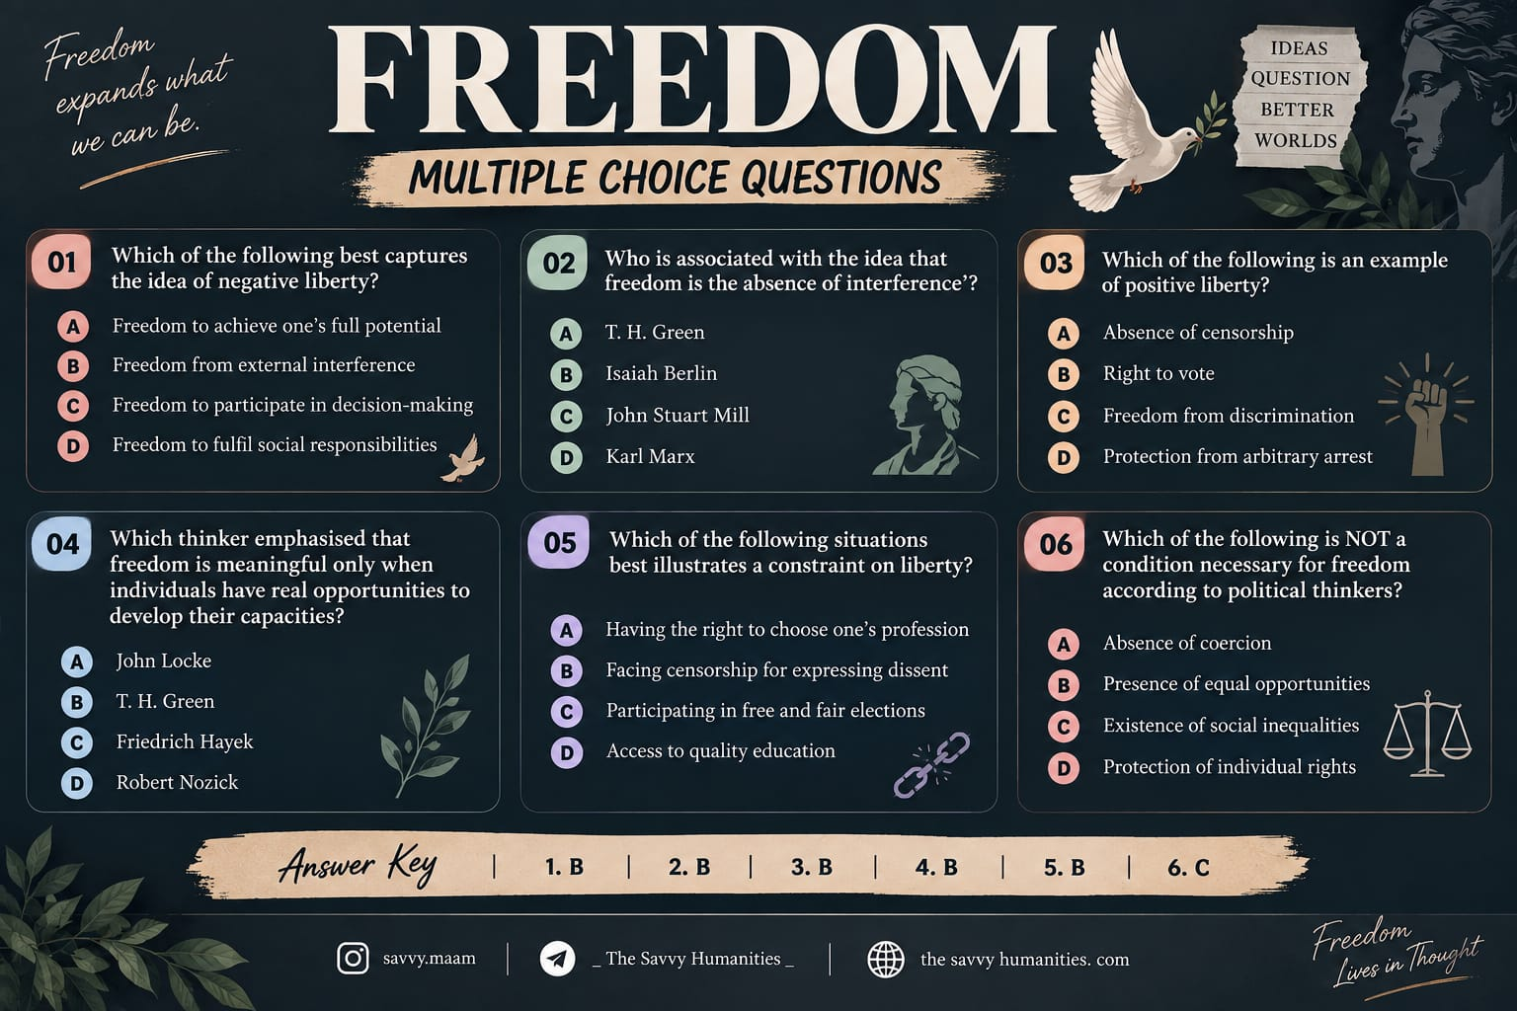
savvy.maam

Slide 11

savvy.maam

Slide 12

savvy.maam

